Slide 1

Assessment of Psychiatric Ward Distribution and Treatment Centers in Israel: Impact on Casualties during the "Haravot Barzel" war
Amit Fallach
13/06/2024
GitHub - https://github.com/amitfallach
Linkedin - https://www.linkedin.com/in/amitfallach/
לזכרו של אלירן מזרחי ז"ל

Slide 2
Executive Summary
The ongoing war since October 7th has led to approximately 16,500 casualties.
This study examines the distribution of casualties by region and the availability of psychiatric wards and treatment centers.
Goal: Identify areas with high casualties and inadequate mental health resources to facilitate rehabilitation post-war.

Slide 3
Problem Overview
The war has caused significant physical and psychological trauma.
There is a need to ensure sufficient mental health resources are available in regions with high casualties.
Identifying discrepancies in resource distribution can help in planning and preparedness for post-war rehabilitation.

Slide 4
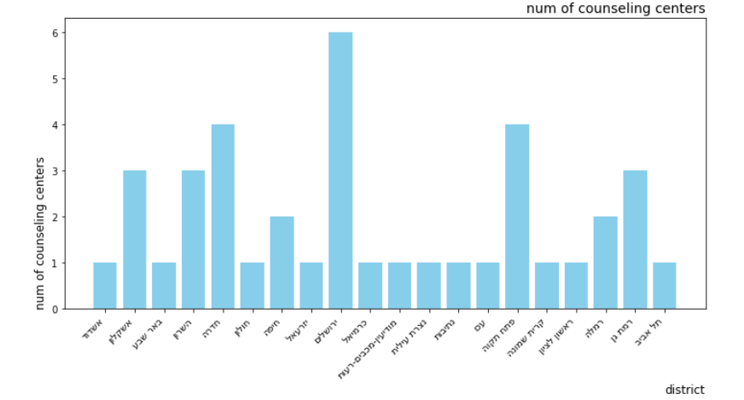
Key findings
Psychological and psychiatric counseling centers by districts: The highest numbers in Jerusalem, Hadera and Petah Tikva.

Slide 5
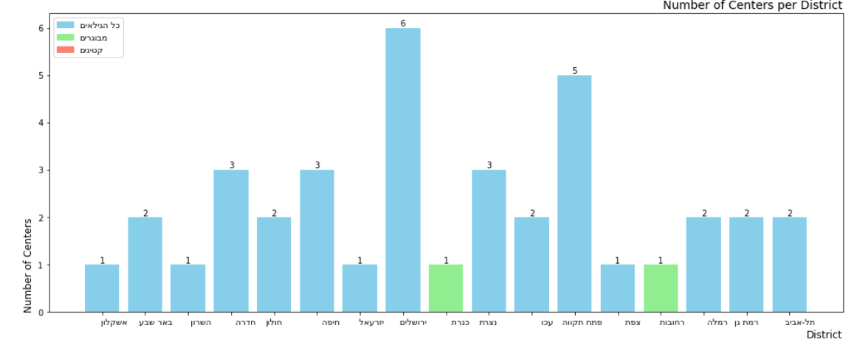
Key findings
Psychiatric departments in hospitals by districts: Jerusalem and Petah Tikva lead in psychiatric departments. Kinneret and Rehovot lack facilities for children and minors.

Slide 6
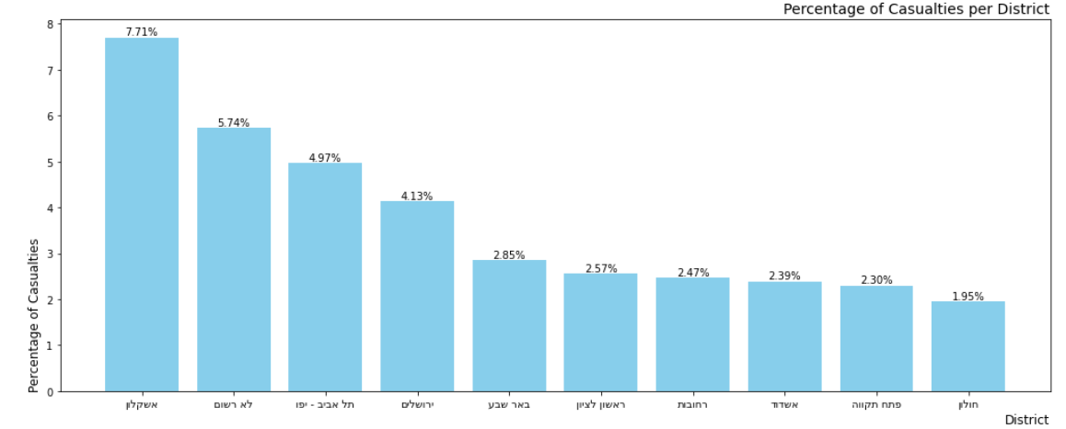
Key findings
Victims by districts: Ashkelon has the highest number of victims (1240, 7.71%). Significant demand for psychiatric services in Ashkelon despite the availability of resources in other districts.

Slide 7
Key findings – final Conclusions
1. Jerusalem and Petah Tikva: these districts show strong support for the treatment of the mentally ill through hospitals, psychiatric wards and social centers.
2. Ashkelon: This district has the highest number of casualties during the war (especially if we also refer to Ashdod and the settlements surrounding Gaza), in addition it can be seen that Ashkelon and the surrounding area do not have a relatively high number of centers, which can indicate an increase in demand for psychiatric and social services. Departments and centers in Ashkelon and the surrounding area must be strengthened.
3. The northern districts: Kinneret and Tiberias lack mental and psychiatric treatment facilities for children and minors, with the nearest facility being in Safed. This gap will become more critical with the return of the evacuees from the north, which requires an in-depth analysis of the demand for such centers or suitable alternatives, especially in the Kinneret district.

Slide 8
Recommendations
In order to improve the near future in terms of mental treatment centers, it seems that the residents of the south should be strengthened, more budgets and personnel should be directed to open more treatment and evaluation centers. Furthermore, the infrastructure in the northern district must be prepared to give an option for mental support to the residents who will return there after the war, with an emphasis on responding to care centers for children and minors.
In addition, it is important to note that the data analysis is based on general statistics of victims, assuming that a physical victim receives a psychological evaluation, treatment and psychological assistance. To deepen the conclusions and to further support the findings, additional data can be collected on the number of hospital beds in each treatment facility, the number of therapists in each place and the proportion of psychological victims from the conflict in relation to all victims. As an engineer specializing in data, my main recommendation is to invest in collecting reliable data at this stage so that in the future we can produce well-founded conclusions that will help us restore the country and society.

